Slide 1
Basics of Boolean Algebra

Slide 2
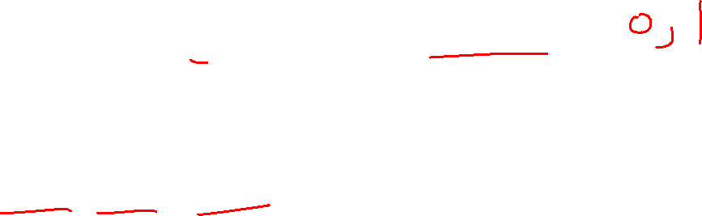
Binary Logic and Gates
Binary variables take on one of two values.
Logical operators operate on binary values and binary variables.
Basic logical operators are the logic functions AND, OR and NOT.
Logic gates implement logic functions.
Boolean Algebra: a useful mathematical system for specifying and transforming logic functions.
We study Boolean algebra as a foundation for designing and analyzing digital systems!

Slide 3
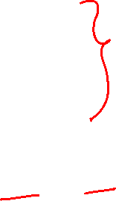
Binary Variables
Recall that the two binary values have different names:
True/False
On/Off
Yes/No
1/0
We use 1 and 0 to denote the two values.

Slide 4
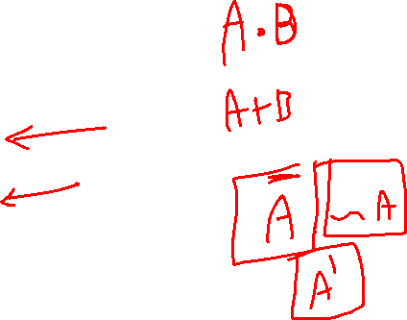
Logical Operations
The three basic logical operations are:
AND
OR
NOT
AND is denoted by a dot (·).
OR is denoted by a plus (+).
NOT is denoted by an overbar ( ¯ ), a single quote mark (') after, or (~) before the variable.

Slide 5

Notation Examples
Examples:
is read “Y is equal to A AND B.”
is read “z is equal to x OR y.”
is read “X is equal to NOT A.”
Y
=
A
⋅
B
z
=
x
+
y
X
=
A
Note: The statement:
1 + 1 = 2 (read “one plus one equals two”)
is not the same as
1 + 1 = 1 (read “1 or 1 equals 1”).

Slide 6
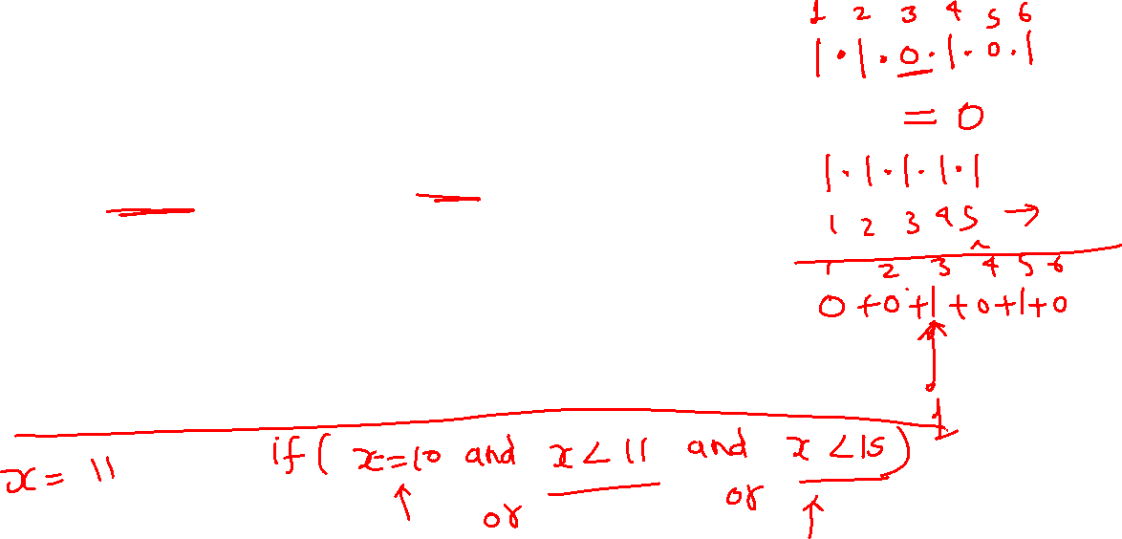
Operator Definitions
Operations are defined on the values "0" and "1" for each operator:
AND
OR
NOT
0 · 0 = 0
0 + 0 = 0
0
=
1
0 · 1 = 0
0 + 1 = 1
1
=
0
1 · 0 = 0
1 + 0 = 1
1 · 1 = 1
1 + 1 = 1

Slide 7
Truth Tables
Truth table − a tabular listing of the values of a function for all possible combinations of values on its arguments
Example: Truth tables for the basic logic operations:
AND
OR
X | Y | Z = X+Y
0 | 0 | 0
0 | 1 | 1
1 | 0 | 1
1 | 1 | 1
NOT
X
Y
Z = X·Y
X
Z
=
X
0
0
0
0
1
0
1
0
1
0
1
0
0
1
1
1

Slide 8

Logic Function Implementation
Using Switches
For inputs:
logic 1 is switch closed
logic 0 is switch open
For outputs:
logic 1 is light on
logic 0 is light off.
NOT uses a switch such
that:
logic 1 is switch open
logic 0 is switch closed
Switches in parallel => OR
Switches in series => AND

Slide 9
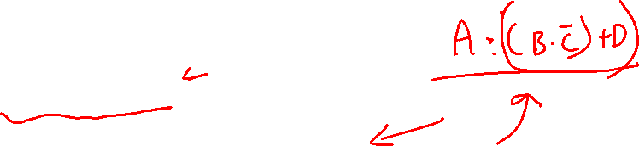
Logic Function Implementation (Continued)
Example: Logic Using Switches
Light is on (L = 1) for
L(A, B, C, D) = ?
and off (L = 0), otherwise.
B
C
A
D
Notes:
L (A, B, C, D) = A ((B C') + D) = A B C' + A D

Slide 10
Logic Gate Symbols and Behavior
Logic gates have special symbols:
And waveform behavior in time as follows:

Slide 11

Buffer
A buffer is a gate with the function F = X:
In terms of Boolean function, a buffer is the same as a connection!
So why use it?
A buffer is an electronic amplifier used to improve circuit voltage levels and increase the speed of circuit operation.
X
F

Slide 12
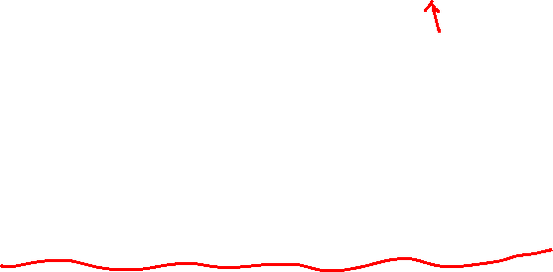
NAND Gate
The basic NAND gate has the following symbol, illustrated for three inputs:
AND-Invert (NAND)
NAND represents NOT AND, i. e., the AND function with a NOT applied. The symbol shown is an AND-Invert. The small circle (“bubble”) represents the invert function.
The NAND gate is a universal gate
X
Y
F
(
X
,
Y
,
Z
)
=
X
⋅
Y
⋅
Z
Z

Slide 13
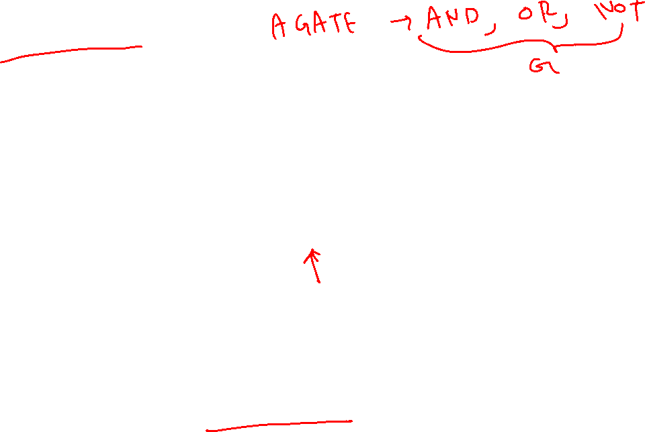
NOR Gate
The basic NOR gate has the following symbol, illustrated for three inputs:
OR-Invert (NOR)
NOR represents NOT - OR, i. e., the OR function with a NOT applied. The symbol shown is an OR-Invert. The small circle (“bubble”) represents the invert function.
The NOR gate is a universal gate
X
Y
F
(
X
,
Y
,
Z
)
=
X
+
Y
+
Z
Z

Slide 14
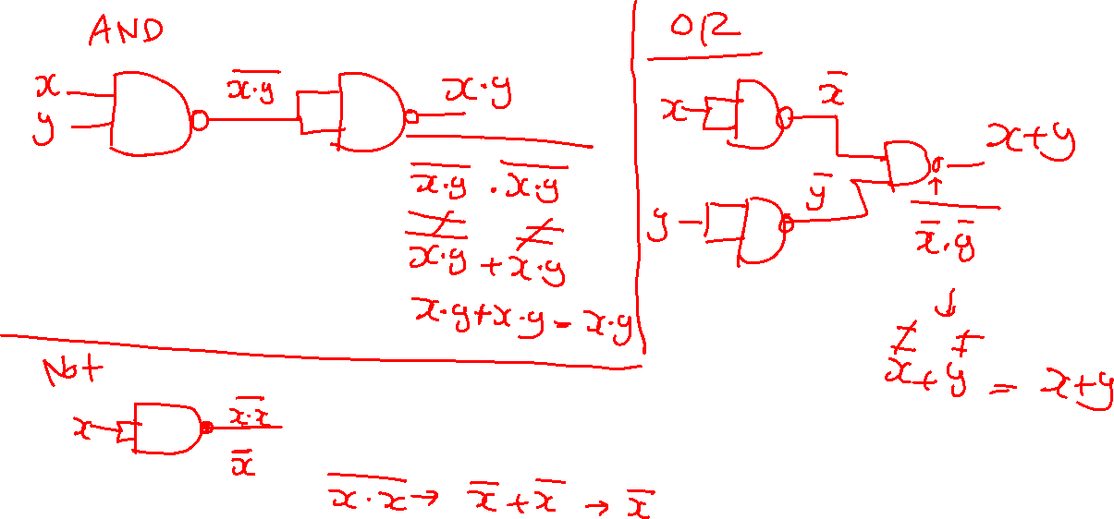
Implement AND, OR, NOT using NAND

Slide 15
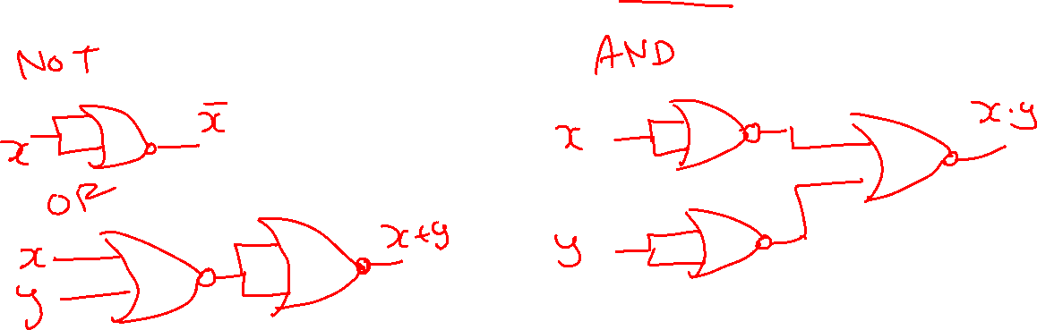
Implement AND, OR, NOT using NOR

Slide 16


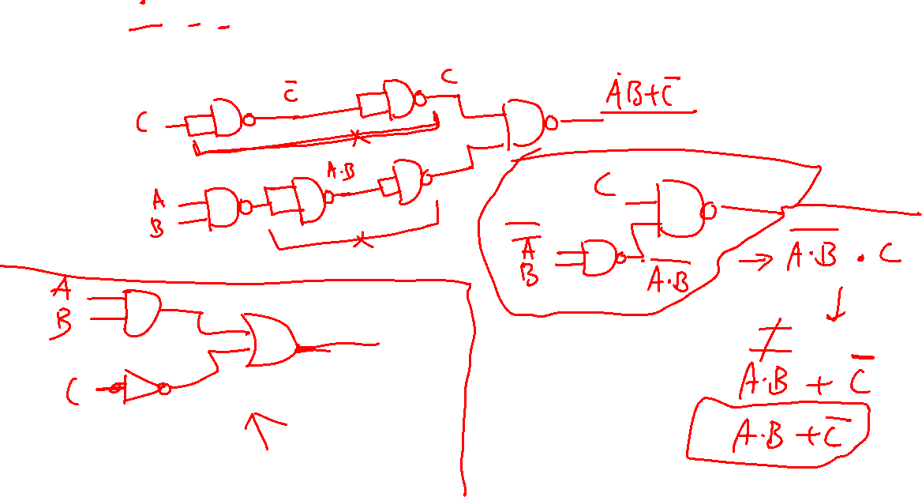

Slide 17
Exclusive OR/ Exclusive NOR
The eXclusive OR (XOR) function is an important Boolean function used extensively in logic circuits.
The eXclusive NOR function is the complement of the XOR function

Slide 18
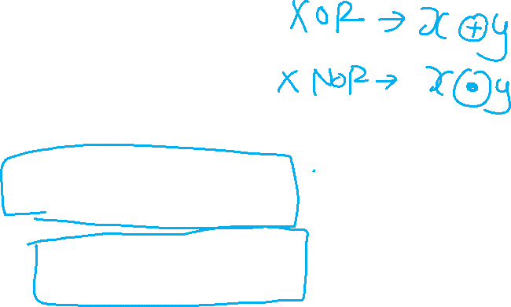
Exclusive OR/ Exclusive NOR
Uses for the XOR and XNORs gate include:
Adders/subtractors/multipliers
Counters/incrementers/decrementers
Parity generators/checkers
Definitions
The XOR function is:
The eXclusive NOR (XNOR) function, otherwise known as equivalence is:
X
⊕
Y
=
X
Y
+
X
Y
X
⊕
Y
=
X
Y
+
X
Y

Slide 19


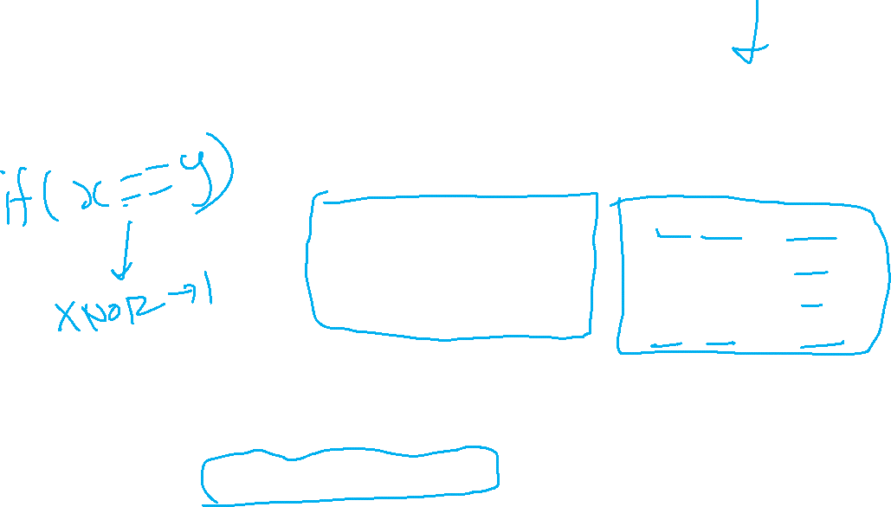
Truth Tables for XOR/XNOR
Operator Rules: XOR XNOR
The XOR function means:
X OR Y, but NOT BOTH
Why is the XNOR function also known as the equivalence function, denoted by the operator ≡
X
Y
X
⊕
Y
X
Y
(X
⊕
Y)
or X
≡
Y
0
0
0
0
0
1
0
1
1
0
1
0
1
0
1
1
0
0
1
1
0
1
1
1
Notes:
Because it is defined as X Y + X’ Y’ that equals 1 if and only if X = Y implying X is equivalent to Y.

Slide 20
Symbols For XOR and XNOR
XOR symbol:
XNOR symbol:

